Slide 1
Big Data, Analytics and the Path From Insights to Value
Joseph Bextermueller, Mark Chafin, David Pruitt, and Lauren Shaffer

Slide 2



Introduction
Topic: MITSloan's "Big Data, Analytics, and the Path From Insights to Value"
Published in 2011
A lot has changed since 2011, for example Apple. They now offer FaceID, AirPods, HomePods, etc. Their services have also grown more advanced.
This Photo by Unknown author is licensed under CC BY-SA.
This Photo by Unknown author is licensed under CC BY-SA-NC.

Slide 3



About the Research
MIT Sloan Management Review teamed up with the IBM Institute for Business Value.
Thanks to this partnership thousands of insights were collected from 108 different countries and 30 different industries.
Interviews and review of IBM cases studies were conducted.
This Photo by Unknown author is licensed under CC BY-NC.
This Photo by Unknown author is licensed under CC BY-SA.

Slide 4
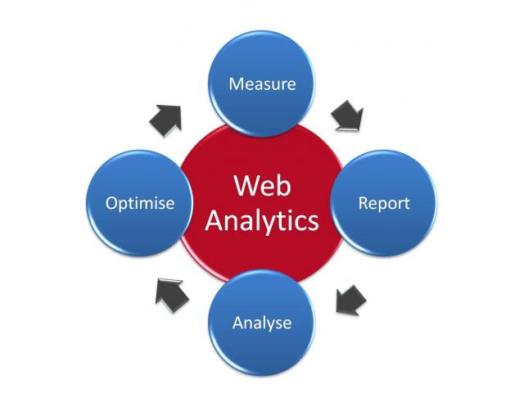
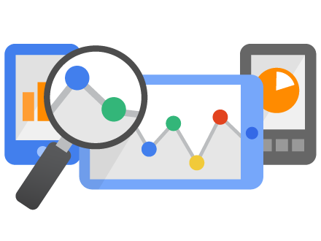
Analytics = Value
The best performing organizations used analytics up to five times more than lower performers.
Improvement of analytics is a massive focus in these organizations.
60% said they had excess data that still needs to be used.
Strong senior desire to run business on data-driven decisions.
This Photo by Unknown author is licensed under CC BY-SA.
This Photo by Unknown author is licensed under CC BY.

Slide 5
Three Levels of Capabilities
From the feedback, MITSloan segmented responses based on organizational rating of analytics usage.

Slide 6



Stage 1: Aspirational
Organizations are furthest from their analytical goals.
Primarily focused on the optimization of current business processes.
Foundation for analytics exist, but are analytics are not a current priority.
This Photo by Unknown author is licensed under CC BY-ND.
This Photo by Unknown author is licensed under CC BY-SA-NC.

Slide 7

Stage 2: Experienced
Analytical experience is gained through success in stage 1.
Cost management is less of a concern.
Begins to optimize management of data in order to improve business.
This Photo by Unknown author is licensed under CC BY-SA.

Slide 8
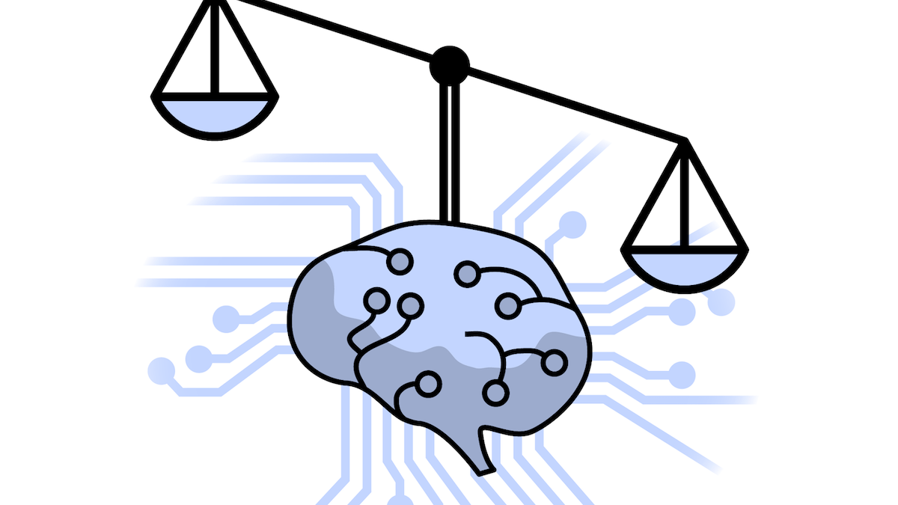
Stage 3: Transformed
High experience with analytics.
Less focused on saving money and more focused on targeted investments through analysis.
3x more likely to outperform industry peers.
This Photo by Unknown author is licensed under CC BY-SA-NC.

Slide 9

Biggest Obstacle: Implementation
Only 1/5 state data quality and governance as an obstacle.
Main issues are organizational.
How do you use analytics to improve business?
Conflicting priorities.
This Photo by Unknown author is licensed under CC BY-SA-NC.

Slide 10
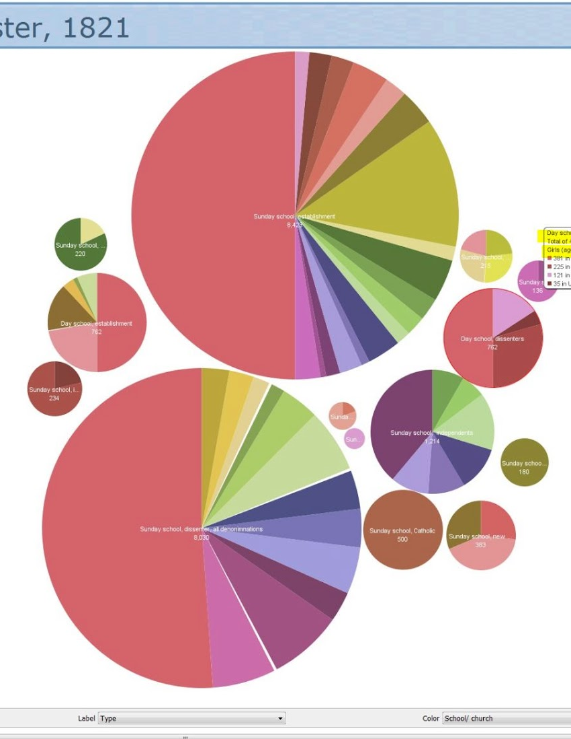
Understandable Information
Information must be easily understandable to it can be acted upon.
Over the next two years executive stated they would be focusing on the replacement of historical reports with newer approaches such as data visualization and process simulation.
This Photo by Unknown author is licensed under CC BY-SA-NC.

Slide 11

Three Critical Management Steps
Reduced time to value: value can be created early, without perfect data.
Increased likelihood of transformation: Analytics can lead to lasting effects that solve many organizational issues.
Greater focus on achievable steps: Narrow and orderly focus on resources. Steps are much easier to tackle when compared to sweeping universal changes.
This Photo by Unknown author is licensed under CC BY-ND.

Slide 12
5 Recommendations
MITSloan then derived 5 recommendations for businesses based on their findings

Slide 13

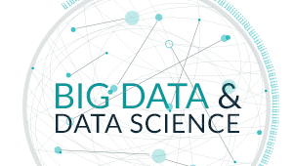
1: Think Biggest
Focus on the biggest and highest value opportunities
Involve top management, seek executive sponsorship and best talent
Don't do analytics without strategic business directions

Slide 14
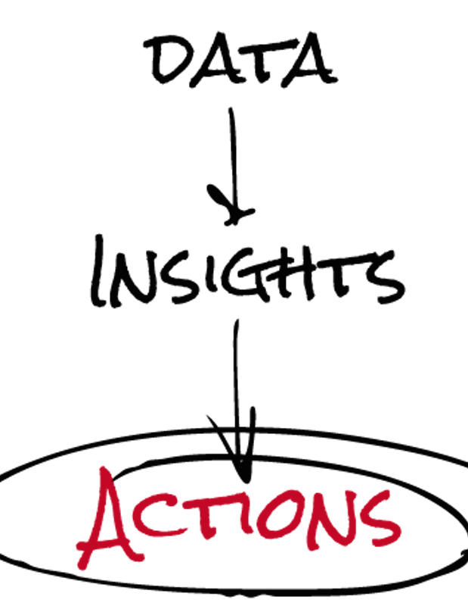
2. Start in the Middle
Start with Questions and insights, not data collection
First Define what insights are desired, then target the subject areas to gather data
Keep the three gears moving – Data, Insight, and Timely Actions
Notes:
Within each opportunity companies should start with questions, not data. More-often-then-not organizations start by gathering all the data available before beginning the analysis. This leads to a focus on data management – collecting, cleaning, and converting data. This leaves little time, energy, or resources to understand the value or potential of the data collected.
Organizations should “start in the middle” when implementing analytics by first defining the insights and questions needed to meet the business objectives, and then identify the data needed to get those answers. This keeps the 3 gears moving – data, insight, and timely actions

Slide 15

3. Make Analytics Come Alive
Embed insights to drive actions and deliver value
Emerging Analytics – Data Visualization, Simulations, Analytics applied within business processes, Advanced statistical techniques
Allows the decision makers to see their sales and choices and to listen to their customers feedback
Notes:
Embed Insights to drive actions and deliver value
Analytics solutions, optimization, work flow, and simulations are making insights more understandable. The respondents named: trend analysis, forecasting, and standardized reporting as the most important tools they use on a daily basis.
Soon, data visualization like dashboards, simulations, analytics, and advanced statistical techniques such as regression analysis became more popular.
These new techniques and approaches transform insights into action and allows the decision makers to see their sales and choices, and allows them to listen to their customers feedback.

Slide 16


4. Add, Don't Detract
Keep existing capabilities while adding new ones
Overtime members bring together ideas, tools, and expertise to inform day-to-day decesions and actions. This demand for insight keeps everyone engaged and expanding.
Data intenstive roles such as finance and supply chain.
Notes:
Add, don’t detract
This does not mean spreadsheets and charts should go away. New tools should supplement older tools or be used along side one another.
With the high demand for analytics, as new ideas come up the existing ideas should also be supported. Adding capabilities without detracting from existing ones is one of the fastest ways to getting full benefits from analytics-driven management.
Disciplines such as finance and supply chain are inherently data intensive and are often where analytics first take off. This idea creates a "snowball effect" as models from one function are repurposed for another with minimal adjustments.

Slide 17


5. Build the Parts, Plan the Whole
Use an information agenda to plan for the future.
Big data is getting bigger
Smart organizations will start with analytics and select the biggest problems.
Information agenda identifies foundational practices while aligning IT and business goals.
Notes:
Big data is getting bigger. Information is coming from instrumented, interconnected supply chains transmitting real-time data about fluctuations in everything from market demand to the weather.
The organization will need to understand how each piece of the data and The information agenda increases the organization’s ability to share and deliver trusted information across all applications and processes.

Slide 18
Conclusion
6 out of 10 companies said they have more data than they know how to use effectively
The highest performing organizations used data analytics up to 5 times more than lower performers.
Need a strong senior desire to run your organization on data-driven decisions.

